Slide 1
Projection of Point and Line
Prepared by
Aghera Nikhil (130540119003)
Thesiya Fenish (130540119107)
Cholera Harsh (130540119020)
Darsandiya Chirag (130540119028)
Guided By
Prof. Subhesh P. Patel
Mechanical Engg. Dept.
Darshan Institute of Engg. And Tech., Rajkot

Slide 2
ORTHOGRAPHIC PROJECTIONS
OF POINTS, LINES, PLANES, AND SOLIDS.
TO DRAW PROJECTIONS OF ANY OBJECT,
ONE MUST HAVE FOLLOWING INFORMATION
A) OBJECT
{ WITH IT’S DESCRIPTION, WELL DEFINED.}
B) OBSERVER
{ ALWAYS OBSERVING PERPENDICULAR TO RESP. REF.PLANE}.
C) LOCATION OF OBJECT,
{ MEANS IT’S POSITION WITH REFFERENCE TO H.P. & V.P.}
TERMS ‘ABOVE’ & ‘BELOW’ WITH RESPECTIVE TO H.P.
AND TERMS ‘INFRONT’ & ‘BEHIND’ WITH RESPECTIVE TO V.P
FORM 4 QUADRANTS.
OBJECTS CAN BE PLACED IN ANY ONE OF THESE 4 QUADRANTS.
IT IS INTERESTING TO LEARN THE EFFECT ON THE POSITIONS OF VIEWS ( FV, TV )
OF THE OBJECT WITH RESP. TO X-Y LINE, WHEN PLACED IN DIFFERENT QUADRANTS.
STUDY ILLUSTRATIONS GIVEN ON HEXT PAGES AND NOTE THE RESULTS.TO MAKE IT EASY
HERE A POINT A IS TAKEN AS AN OBJECT. BECAUSE IT’S ALL VIEWS ARE JUST POINTS.

Slide 3
NOTATIONS
FOLLOWING NOTATIONS SHOULD BE FOLLOWED WHILE NAMEING
DIFFERENT VIEWS IN ORTHOGRAPHIC PROJECTIONS.
OBJECT POINT A LINE AB
IT’S TOP VIEW a a b
IT’S FRONT VIEW a’ a’ b’
IT’S SIDE VIEW a” a” b”
SAME SYSTEM OF NOTATIONS SHOULD BE FOLLOWED
INCASE NUMBERS, LIKE 1, 2, 3 – ARE USED.

Slide 4
2nd Quadrant
VP
2nd Quad.
1ST Quad.
F.V.
1st Quadrant
Y
Observer
X Y
HP
X
3rdQuadrant
Observer
3rd Quad.
4th Quad.
4th Quadrant
THIS QUADRANT PATTERN,
IF OBSERVED ALONG X-Y LINE ( IN RED ARROW DIRECTION)
WILL EXACTLY APPEAR AS SHOWN ON RIGHT SIDE AND HENCE,
IT IS FURTHER USED TO UNDERSTAND ILLUSTRATION PROPERLLY.

Slide 5
Point A is
Placed In
different
quadrants
and it’s Fv & Tv
are brought in
same plane for
Observer to see
clearly.
Fv is visible as
it is a view on
VP. But as Tv is
is a view on Hp,
it is rotated
downward 90⁰,
In clockwise
direction.The
In front part of
Hp comes below
xy line and the
part behind Vp
comes above.
Observe and
note the
process.
POINT A IN
2ND QUADRANT
VP
POINT A IN
1ST QUADRANT
VP
a’
A
A
a’
a
HP
OBSERVER
HP
OBSERVER
a
a
HP
HP
OBSERVER
OBSERVER
a
a’
A
a’
POINT A IN
3RD QUADRANT
A
POINT A IN
4TH QUADRANT
VP
VP

Slide 6
PROJECTIONS OF A POINT IN FIRST QUADRANT.
POINT A ABOVE HP
& INFRONT OF VP
POINT A ABOVE HP
& IN VP
POINT A IN HP
& INFRONT OF VP
For Tv
For Tv
PICTORIAL
PRESENTATION
PICTORIAL
PRESENTATION
For Tv
a’
a’
A
A
For Fv
Y
Y
Y
For Fv
a
a’
X
a
a
X
X
A
For Fv
ORTHOGRAPHIC PRESENTATIONS
OF ALL ABOVE CASES.
Fv above xy,
Tv below xy.
Fv above xy,
Tv on xy.
Fv on xy,
Tv below xy.
VP
VP
VP
a’
a’
X
Y
X
Y
X
a’
Y
a
a
a
HP
HP
HP

Slide 7
PROJECTIONS OF STRAIGHT LINES.
INFORMATION REGARDING A LINE means
IT’S LENGTH,
POSITION OF IT’S ENDS WITH HP & VP
IT’S INCLINATIONS WITH HP & VP WILL BE GIVEN.
AIM:- TO DRAW IT’S PROJECTIONS - MEANS FV & TV.
SIMPLE CASES OF THE LINE
A VERTICAL LINE ( LINE PERPENDICULAR TO HP & // TO VP)
LINE PARALLEL TO BOTH HP & VP.
LINE INCLINED TO HP & PARALLEL TO VP.
LINE INCLINED TO VP & PARALLEL TO HP.
LINE INCLINED TO BOTH HP & VP.
STUDY ILLUSTRATIONS GIVEN ON NEXT PAGE
SHOWING CLEARLY THE NATURE OF FV & TV
OF LINES LISTED ABOVE AND NOTE RESULTS.

Slide 8
For Tv
Orthographic Pattern
(Pictorial Presentation)
V.P.
a’
Note:
Fv is a vertical line
Showing True Length
&
Tv is a point.
a’
1.
V.P.
A
Fv
FV
A Line
perpendicular
to Hp
&
// to Vp
b’
b’
Y
X
Y
B
For Fv
TV
a b
X
Tv
a b
H.P.
Orthographic Pattern
(Pictorial Presentation)
Note:
Fv & Tv both are
// to xy
&
both show T. L.
V.P.
For Tv
2.
a’
Fv
b’
V.P.
b’
A Line
// to Hp
&
// to Vp
F.V.
B
a’
A
Y
X
Y
For Fv
b
a
b
T.V.
Tv
X
a
H.P.

Slide 9
Fv inclined to xy
Tv parallel to xy.
V.P.
3.
V.P.
b’
b’
A Line inclined to Hp
and
parallel to Vp
(Pictorial presentation)
B
F.V.
F.V.
a’
θ
θ
Y
X
Y
a’
θ
A
b
a
T.V.
b
X
T.V.
a
H.P.
Orthographic Projections
Tv inclined to xy
Fv parallel to xy.
V.P.
4.
V.P.
Fv
A Line inclined to Vp
and
parallel to Hp
(Pictorial presentation)
F.V.
b’
a’
b’
a’
A
Ø
B
X
Y
a
Ø
a
Ø
b
Tv
T.V.
b
H.P.

Slide 10
For Tv
For Tv
5.
A Line inclined to both
Hp and Vp
(Pictorial presentation)
b’
b’
V.P.
V.P.
B
F.V.
B
F.V.
α
α
Y
Y
On removal of object
i.e. Line AB
Fv as a image on Vp.
Tv as a image on Hp,
a’
a’
For Fv
For Fv
A
A
β
X
β
X
a
T.V.
b
a
T.V.
b
V.P.
b’
FV
a’
α
X
Y
Orthographic Projections
Fv is seen on Vp clearly.
To see Tv clearly, HP is rotated 90⁰ downwards,
Hence it comes below xy.
Note These Facts:-
Both Fv & Tv are inclined to xy.
(No view is parallel to xy)
Both Fv & Tv are reduced lengths.
(No view shows True Length)
a
β
TV
H.P.
b

Slide 11
Orthographic Projections
Means Fv & Tv of Line AB
are shown below,
with their apparent Inclinations
α & β
Note the procedure
When Fv & Tv known,
How to find True Length.
(Views are rotated to determine
True Length & it’s inclinations
with Hp & Vp).
Note the procedure
When True Length is known,
How to locate Fv & Tv.
(Component a-1 of TL is drawn
which is further rotated
to determine Fv)
V.P.
V.P.
V.P.
b’
b’
b₁’
b’
b₁’
FV
FV
Fv
TL
a’
α
TL
a’
θ
α
a’
θ
1’
X
Y
X
Y
X
Y
a
1
a
β
a
β
TV
b₂
Ø
β
TV
TV
Tv
TL
H.P.
b
H.P.
b
H.P.
b
b₁
Here TV (ab) is not // to XY line
Hence it’s corresponding FV
a’ b’ is not showing
True Length &
True Inclination with Hp.
In this sketch, TV is rotated
and made // to XY line.
Hence it’s corresponding
FV a’ b₁’ Is showing
True Length
&
True Inclination with Hp.
Here a -1 is component
of TL ab₁ gives length of Fv.
Hence it is brought Up to
Locus of a’ and further rotated
to get point b’. a’ b’ will be Fv.
Similarly drawing component
of other TL(a’ b₁‘) Tv can be drawn.

Slide 12
The most important diagram showing graphical relations
among all important parameters of this topic.
Study and memorize it as a CIRCUIT DIAGRAM
And use in solving various problems.
1) True Length ( TL) – a’ b₁’ & a b
2) Angle of TL with Hp -
θ
Important
TEN parameters
to be remembered
with Notations
used here onward
3) Angle of TL with Vp –
Ø
4) Angle of FV with xy –
α
V.P.
5) Angle of TV with xy –
β
Distance between
End Projectors.
6) LTV (length of FV) – Component (a-1)
b’
b₁’
7) LFV (length of TV) – Component (a’-1’)
8) Position of A- Distances of a & a’ from xy
Fv
TL
9) Position of B- Distances of b & b’ from xy
α
10) Distance between End Projectors
a’
θ
1’
LTV
NOTE this
θ
&
α
Construct with a’
X
Y
a
LFV
1
Ø
&
β
Construct with a
Ø
b’ & b₁’ on same locus.
β
b & b₁ on same locus.
Tv
TL
b₁
Also Remember
H.P.
b
True Length is never rotated. It’s horizontal component is drawn & it is further rotated to locate view.
Views are always rotated, made horizontal & further extended to locate TL, θ & Ø

Slide 13
GROUP (A)
GENERAL CASES OF THE LINE INCLINED TO BOTH HP & VP
( based on 10 parameters).
PROBLEM 1)
Line AB is 75 mm long and it is 30⁰ &
40⁰ Inclined to Hp & Vp respectively.
End A is 12mm above Hp and 10 mm
in front of Vp.
Draw projections. Line is in 1st quadrant.
b’
b’₁
FV
SOLUTION STEPS:
1) Draw xy line and one projector.
2) Locate a’ 12mm above xy line
& a 10mm below xy line.
3) Take 30⁰ angle from a’ & 40⁰ from
a and mark TL I.e. 75mm on both
lines. Name those points b₁’ and b₁
respectively.
4) Join both points with a’ and a resp.
5) Draw horizontal lines (Locus) from
both points.
6) Draw horizontal component of TL
a b₁ from point b₁ and name it 1.
( the length a-1 gives length of Fv as we have seen already.)
7) Extend it up to locus of a’ and rotating a’ as center locate b’ as shown. Join a’ b’ as Fv.
8) From b’ drop a projector down ward & get point b. Join a & b I.e. Tv.
TL
θ
a’
X
Y
a
LFV
Ø
1
TV
TL
b
b₁

Slide 14
PROBLEM 2:
Line AB 75mm long makes 45⁰ inclination with Vp while it’s Fv makes 55⁰.
End A is 10 mm above Hp and 15 mm in front of Vp.If line is in 1st quadrant
draw it’s projections and find it’s inclination with Hp.
b’
b’₁
LOCUS OF b₁’
Solution Steps:-
1.Draw x-y line.
2.Draw one projector for a’ & a
3.Locate a’ 10mm above x-y &
Tv a 15 mm below xy.
4.Draw a line 45⁰ inclined to xy
from point a and cut TL 75 mm
on it and name that point b₁
Draw locus from point b₁
5.Take 55⁰ angle from a’ for Fv
above xy line.
6.Draw a vertical line from b₁
up to locus of a and name it 1.
It is horizontal component of
TL & is LFV.
7.Continue it to locus of a’ and
rotate upward up to the line
of Fv and name it b’.This a’ b’
line is Fv.
8. Drop a projector from b’ on
locus from point b₁ and
name intersecting point b.
Line a b is Tv of line AB.
9.Draw locus from b’ and from
a’ with TL distance cut point b₁‘
10.Join a’ b₁’ as TL and measure
it’s angle at a’.
It will be true angle of line with HP.
FV
TL
55⁰
a’
X
y
a
LFV
1
Φ 45⁰
TV
TL
LOCUS OF b
b
b₁

Slide 15
PROBLEM 3: Fv of line AB is 50⁰ inclined to xy and measures 55 mm long while it’s Tv is 60⁰ inclined to xy line. If end A is 10 mm above Hp and 15 mm in front of Vp, draw it’s projections,find TL, inclinations of line with Hp & Vp.
b’
b’₁
SOLUTION STEPS:
1.Draw xy line and one projector.
2.Locate a’ 10 mm above xy and
a 15 mm below xy line.
3.Draw locus from these points.
4.Draw Fv 50⁰ to xy from a’ and
mark b’ Cutting 55mm on it.
5.Similarly draw Tv 60⁰ to xy
from a & drawing projector from b’
Locate point b and join a b.
6.Then rotating views as shown,
locate True Lengths ab₁ & a’b₁’
and their angles with Hp and Vp.
FV
TL
50⁰
θ
X
a’
y
a
Φ
60⁰
TL
b₁
b

Slide 16
PROBLEM 4 :-
Line AB is 75 mm long .It’s Fv and Tv measure 50 mm & 60 mm long respectively.
End A is 10 mm above Hp and 15 mm in front of Vp. Draw projections of line AB
if end B is in first quadrant.Find angle with Hp and Vp.
b’
b’₁
SOLUTION STEPS:
1.Draw xy line and one projector.
2.Locate a’ 10 mm above xy and
a 15 mm below xy line.
3.Draw locus from these points.
4.Cut 60mm distance on locus of a’
& mark 1’ on it as it is LTV.
5.Similarly Similarly cut 50mm on
locus of a and mark point 1 as it is LFV.
6.From 1’ draw a vertical line upward
and from a’ taking TL ( 75mm ) in
compass, mark b’₁ point on it.
Join a’ b’₁ points.
7. Draw locus from b’₁
8. With same steps below get b₁ point
and draw also locus from it.
9. Now rotating one of the components
I.e. a-1 locate b’ and join a’ with it
to get Fv.
10. Locate tv similarly and measure
Angles
FV
TL
θ
LTV
1’
a’
X
Y
a
LFV
1
Φ
TV
TL
θ
&
Φ
b₁
b

Slide 17
GROUP (B)
PROBLEMS INVOLVING TRACES OF THE LINE.
TRACES OF THE LINE:-
THESE ARE THE POINTS OF INTERSECTIONS OF A LINE ( OR IT’S EXTENSION )
WITH RESPECTIVE REFFERENCE PLANES.
A LINE ITSELF OR IT’S EXTENSION, WHERE EVER TOUCHES H.P.,
THAT POINT IS CALLED TRACE OF THE LINE ON H.P.( IT IS CALLED H.T.)
SIMILARLY, A LINE ITSELF OR IT’S EXTENSION, WHERE EVER TOUCHES V.P.,
THAT POINT IS CALLED TRACE OF THE LINE ON V.P.( IT IS CALLED V.T.)
V.T.:- It is a point on Vp.
Hence it is called Fv of a point in Vp.
Hence it’s Tv comes on XY line.( Here onward named as v )
H.T.:- It is a point on Hp.
Hence it is called Tv of a point in Hp.
Hence it’s Fv comes on XY line.( Here onward named as ’h’ )

Slide 18
b’
STEPS TO LOCATE HT.
(WHEN PROJECTIONS ARE GIVEN.)
FV
Begin with FV. Extend FV up to XY line.
Name this point h’
( as it is a Fv of a point in Hp)
3. Draw one projector from h’.
4. Now extend Tv to meet this projector.
This point is HT
a’
x
v
h’
y
VT’
HT
a
STEPS TO LOCATE VT.
(WHEN PROJECTIONS ARE GIVEN.)
TV
Observe & note :-
1. Points h’ & v always on x-y line.
2. VT’ & v always on one projector.
3. HT & h’ always on one projector.
4. FV - h’- VT’ always co-linear.
5. TV - v - HT always co-linear.
Begin with TV. Extend TV up to XY line.
Name this point v
( as it is a Tv of a point in Vp)
3. Draw one projector from v.
4. Now extend Fv to meet this projector.
This point is VT
b
These points are used to
solve next three problems.

Slide 19
PROBLEM 6 :- Fv of line AB makes 45⁰ angle with XY line and measures 60 mm.
Line’s Tv makes 30⁰ with XY line. End A is 15 mm above Hp and it’s VT is 10 mm
below Hp. Draw projections of line AB,determine inclinations with Hp & Vp and locate HT, VT.
b’
b’₁
a’
θ
45⁰
15
v
SOLUTION STEPS:-
Draw xy line, one projector and
locate fv a’ 15 mm above xy.
Take 45⁰ angle from a’ and
marking 60 mm on it locate point b’.
Draw locus of VT, 10 mm below xy
& extending Fv to this locus locate VT.
as fv-h’-vt’ lie on one st.line.
Draw projector from vt, locate v on xy.
From v take 30⁰ angle downward as
Tv and it’s inclination can begin with v.
Draw projector from b’ and locate b I.e.Tv point.
Now rotating views as usual TL and
it’s inclinations can be found.
Name extension of Fv, touching xy as h’
and below it, on extension of Tv, locate HT.
x
h’
y
10
30⁰
HT
VT’
a
∅
b
b₁

Slide 20
PROBLEM 7 :
One end of line AB is 10mm above Hp and other end is 100 mm in-front of Vp.
It’s Fv is 45⁰ inclined to xy while it’s HT & VT are 45mm and 30 mm below xy respectively.
Draw projections and find TL with it’s inclinations with Hp & VP.
b’
b’₁
LOCUS OF b’ & b’₁
FV
TL
a’
θ
45⁰
10
v
h’
Y
X
30
45
VT’
HT
SOLUTION STEPS:-
Draw xy line, one projector and
locate a’ 10 mm above xy.
Draw locus 100 mm below xy for points b & b₁
Draw loci for VT and HT, 30 mm & 45 mm
below xy respectively.
Take 45⁰ angle from a’ and extend that line backward
to locate h’ and VT, & Locate v on xy above VT.
Locate HT below h’ as shown.
Then join v – HT – and extend to get top view end b.
Draw projector upward and locate b’ Make a b & a’b’ dark.
Now as usual rotating views find TL and it’s inclinations.
100
a
Φ
TL
TV
b
b₁
LOCUS OF b & b₁

Slide 21
PROBLEM 8 :- Projectors drawn from HT and VT of a line AB
are 80 mm apart and those drawn from it’s ends are 50 mm apart.
End A is 10 mm above Hp, VT is 35 mm below Hp
while it’s HT is 45 mm in front of Vp. Draw projections,
locate traces and find TL of line & inclinations with Hp and Vp.
VT
b’
b’₁
SOLUTION STEPS:-
1.Draw xy line and two projectors,
80 mm apart and locate HT & VT ,
35 mm below xy and 55 mm above xy
respectively on these projectors.
2.Locate h’ and v on xy as usual.
3.Now just like previous two problems,
Extending certain lines complete Fv & Tv
And as usual find TL and it’s inclinations.
FV
55
TL
Locus of a’
a’
θ
X
10
50
v
y
h’
b
b ₁
TV
35
TL
a
Φ
HT
80

Slide 22
Instead of considering a & a’ as projections of first point,
if v & VT’ are considered as first point , then true inclinations of line with
Hp & Vp i.e. angles θ & Φ can be constructed with points VT’ & V respectively.
b’
b₁’
FV
TL
Then from point v & HT
angles can be drawn.
&
From point VT’ & h’
angles can be drawn.
a’
β
Φ
&
X
v
Φ
Y
α
&
θ
θ
VT’
THIS CONCEPT IS USED TO SOLVE
NEXT THREE PROBLEMS.
a
TL
TV
b
b₁

Slide 23
PROBLEM 9 :-
Line AB 100 mm long is 30⁰ and 45⁰ inclined to Hp & Vp respectively.
End A is 10 mm above Hp and it’s VT is 20 mm below Hp
.Draw projections of the line and it’s HT.
b’
b₁’
FV
100 mm
Locus of a & a₁’
a’
a₁’
SOLUTION STEPS:-
Draw xy, one projector
and locate on it VT and V.
Draw locus of a’ 10 mm above xy.
Take 30⁰ from VT and draw a line.
Where it intersects with locus of a’
name it a₁’ as it is TL of that part.
From a₁’ cut 100 mm (TL) on it and locate point b₁’
Now from v take 45⁰ and draw a line downwards
& Mark on it distance VT-a₁’ I.e.TL of extension & name it a₁
Extend this line by 100 mm and mark point b_{1.}
Draw it’s component on locus of VT’
& further rotate to get other end of Fv i.e.b’
Join it with VT’ and mark intersection point
(with locus of a₁’ ) and name it a’
Now as usual locate points a and b and h’ and HT.
10
v
h’
X
Y
Φ(45⁰)
20
θ (30⁰)
VT’
HT
a
a₁
TV
100 mm
b
b₁

Slide 24
PROBLEM 10 :-
A line AB is 75 mm long. It’s Fv & Tv make 45⁰ and 60⁰ inclinations with X-Y line resp
End A is 15 mm above Hp and VT is 20 mm below Xy line. Line is in first quadrant.
Draw projections, find inclinations with Hp & Vp. Also locate HT.
b’
b₁’
FV
75 mm
Locus of a & a₁’
a’
a₁’
15
v
h’
X
Y
60⁰
Φ
20
45⁰
θ
VT’
SOLUTION STEPS:-
Similar to the previous only change
is instead of line’s inclinations,
views inclinations are given.
So first take those angles from VT & v
Properly, construct Fv & Tv of extension,
then determine it’s TL( V-a₁)
and on it’s extension mark TL of line
and proceed and complete it.
HT
a
a₁
TV
75 mm
b
b₁

Slide 25
PROBLEM 11 :- The projectors drawn from VT & end A of line AB are 40mm apart.
End A is 15mm above Hp and 25 mm in front of Vp. VT of line is 20 mm below Hp.
If line is 75mm long, draw it’s projections, find inclinations with HP & Vp
b’
b₁’
FV
75mm
a’
a₁’
15
v
X
Y
20
θ
Φ
25
VT’
a
Draw two projectors for VT & end A
Locate these points and then
YES !
YOU CAN COMPLETE IT.
40mm
TV
b
b₁

Slide 26
PROBLEM 5 :-
T.V. of a 75 mm long Line CD, measures 50 mm.
End C is in Hp and 50 mm in front of Vp.
End D is 15 mm in front of Vp and it is above Hp.
Draw projections of CD and find angles with Hp and Vp.
d’
d’₁
LOCUS OF d’ & d’₁
SOLUTION STEPS:
1.Draw xy line and one projector.
2.Locate c’ on xy and
c 50mm below xy line.
3.Draw locus from these points.
4.Draw locus of d 15 mm below xy
5.Cut 50mm & 75 mm distances on
locus of d from c and mark points
d & d₁ as these are Tv and line CD
lengths resp.& join both with c.
6.From d₁ draw a vertical line upward
up to xy I.e. up to locus of c’ and
draw an arc as shown.
7 Then draw one projector from d to
meet this arc in d’ point & join c’ d’
8. Draw locus of d’ and cut 75 mm
on it from c’ as TL
9.Measure Angles
FV
TL
X
c’
θ
Y
d
_{d1}
LOCUS OF d & d₁
TL
TV
θ
&
Φ
c
Φ

Slide 27
GROUP (C)
CASES OF THE LINES IN A.V.P., A.I.P. & PROFILE PLANE.
b’
Line AB is in AIP as shown in above figure no 1.
It’s FV (a’b’) is shown projected on Vp.(Looking in arrow direction)
Here one can clearly see that the
Inclination of AIP with HP = Inclination of FV with XY line
A.I.P.
a’
α
B
X
A
α
β
A
A.V.P.
B
Line AB is in AVP as shown in above figure no 2..
It’s TV (a b) is shown projected on Hp.(Looking in arrow direction)
Here one can clearly see that the
Inclination of AVP with VP = Inclination of TV with XY line
β
a
b

Slide 28
LINE IN A PROFILE PLANE ( MEANS IN A PLANE PERPENDICULAR TO BOTH HP & VP)
For T.V.
ORTHOGRAPHIC PATTERN OF LINE IN PROFILE PLANE
VP
VT
PP
a’
a’
a”
A
Φ
FV
LSV
b’
b’
b”
θ
X
Y
HT
a
B
For F.V.
TV
a
b
b
HP
Results:-
1. TV & FV both are vertical, hence arrive on one single projector.
2. It’s Side View shows True Length ( TL)
3. Sum of it’s inclinations with HP & VP equals to 90⁰ (
4. It’s HT & VT arrive on same projector and can be easily located
From Side View.
θ
+
Φ
= 90⁰ )
OBSERVE CAREFULLY ABOVE GIVEN ILLUSTRATION AND 2nd SOLVED PROBLEM.

Slide 29
PROBLEM 12 :- Line AB 80 mm long, makes 30⁰ angle with Hp
and lies in an Aux.Vertical Plane 45⁰ inclined to Vp.
End A is 15 mm above Hp and VT is 10 mm below X-y line.
Draw projections, fine angle with Vp and Ht.
b’
Locus of b’
b₁’
Locus of a’ & a₁’
a’
a₁’
15
v
h’
X
45⁰
θ
Y
10
Φ
VT
HT
a
AVP 45⁰ to VP
Simply consider inclination of AVP
as inclination of TV of our line,
well then?
You sure can complete it
as previous problems!
Go ahead!!
Locus of b’
b
b₁

Slide 30
PROBLEM 13 :- A line AB, 75mm long, has one end A in Vp. Other end B is 15 mm above Hp
and 50 mm in front of Vp.Draw the projections of the line when sum of it’s
Inclinations with HP & Vp is 90⁰, means it is lying in a profile plane.
Find true angles with ref.planes and it’s traces.
VT
(VT)
a”
a’
SOLUTION STEPS:-
After drawing xy line and one projector
Locate top view of A I.e point a on xy as
It is in Vp,
Locate Fv of B i.e.b’15 mm above xy as
it is above Hp.and Tv of B i.e. b, 50 mm
below xy asit is 50 mm in front of Vp
Draw side view structure of Vp and Hp
and locate S.V. of point B i.e. b’’
From this point cut 75 mm distance on Vp and
Mark a’’ as A is in Vp. (This is also VT of line.)
From this point draw locus to left & get a’
Extend SV up to Hp. It will be HT. As it is a Tv
Rotate it and bring it on projector of b.
Now as discussed earlier SV gives TL of line
and at the same time on extension up to Hp & Vp
gives inclinations with those panes.
Φ
Front view
Side View
( True Length )
VP
b’
b”
a
θ
(HT)
X
HP
Y
top view
b
HT

Slide 31
APPLICATIONS OF PRINCIPLES OF PROJECTIONS OF LINES
IN SOLVING CASES OF DIFFERENT PRACTICAL SITUATIONS.
In these types of problems some situation in the field
or
some object will be described .
It’s relation with Ground ( HP )
And
a Wall or some vertical object ( VP ) will be given.
Indirectly information regarding Fv & Tv of some line or lines,
inclined to both reference Planes will be given
and
you are supposed to draw it’s projections
and
further to determine it’s true Length and it’s inclinations with ground.
Here various problems along with
actual pictures of those situations are given
for you to understand those clearly.
Now looking for views in given ARROW directions,
YOU are supposed to draw projections & find answers,
Off course you must visualize the situation properly.
CHECK YOUR ANSWERS
WITH THE SOLUTIONS
GIVEN IN THE END.
ALL THE BEST !!

Slide 32
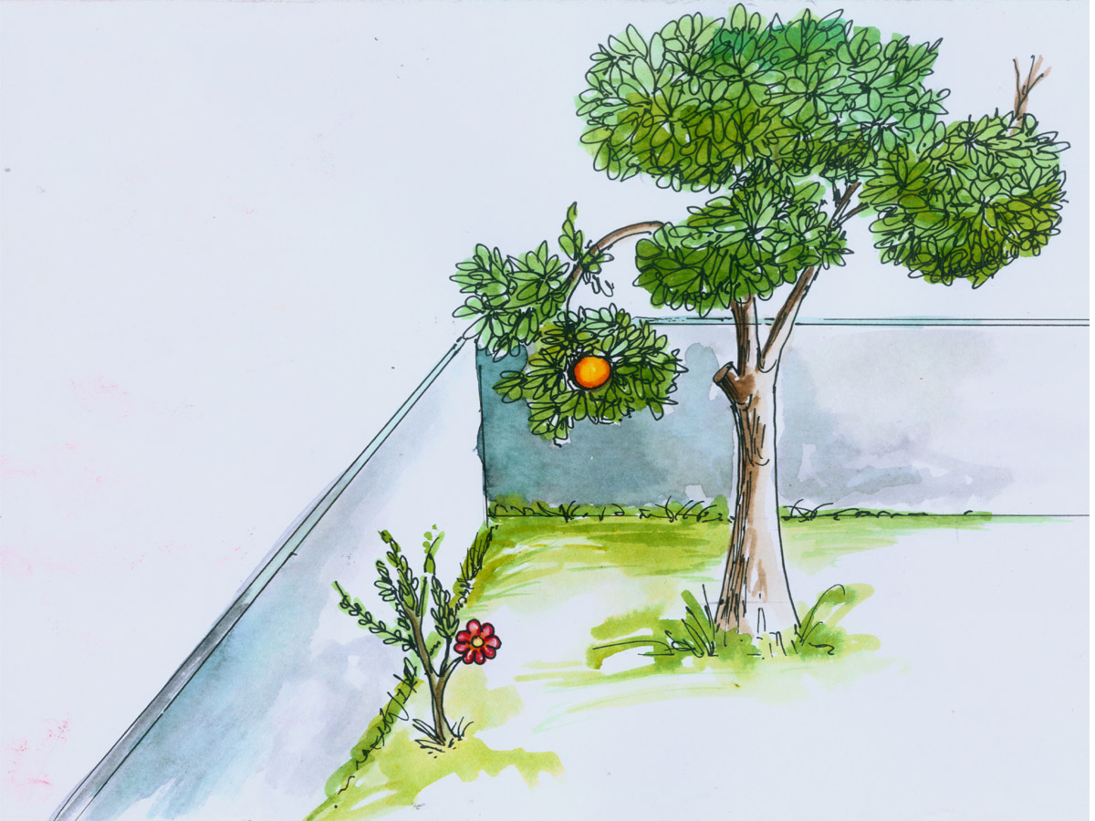
PROBLEM 14:-Two objects, a flower (A) and an orange (B) are within a rectangular compound wall,
whose P & Q are walls meeting at 90⁰. Flower A is 1M & 5.5 M from walls P & Q respectively.
Orange B is 4M & 1.5M from walls P & Q respectively. Drawing projection, find distance between them
If flower is 1.5 M and orange is 3.5 M above the ground. Consider suitable scale..
TV
B
Wall Q
Wall P
A
FV

Slide 33
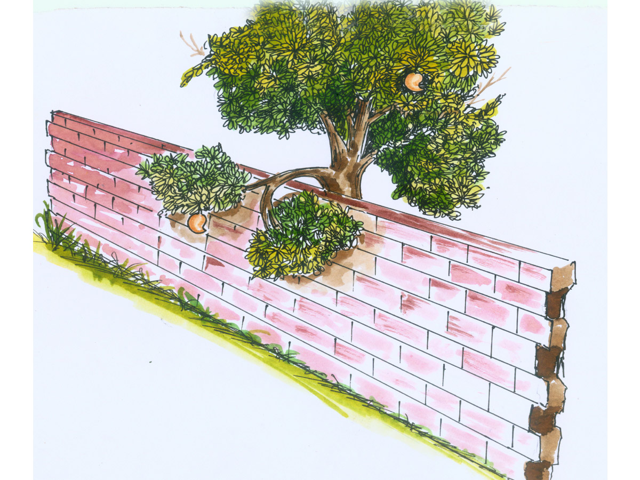
PROBLEM 15 :- Two mangos on a tree A & B are 1.5 m and 3.00 m above ground
and those are 1.2 m & 1.5 m from a 0.3 m thick wall but on opposite sides of it.
If the distance measured between them along the ground and parallel to wall is 2.6 m,
Then find real distance between them by drawing their projections.
TV
B
0.3M THICK
A
FV

Slide 34
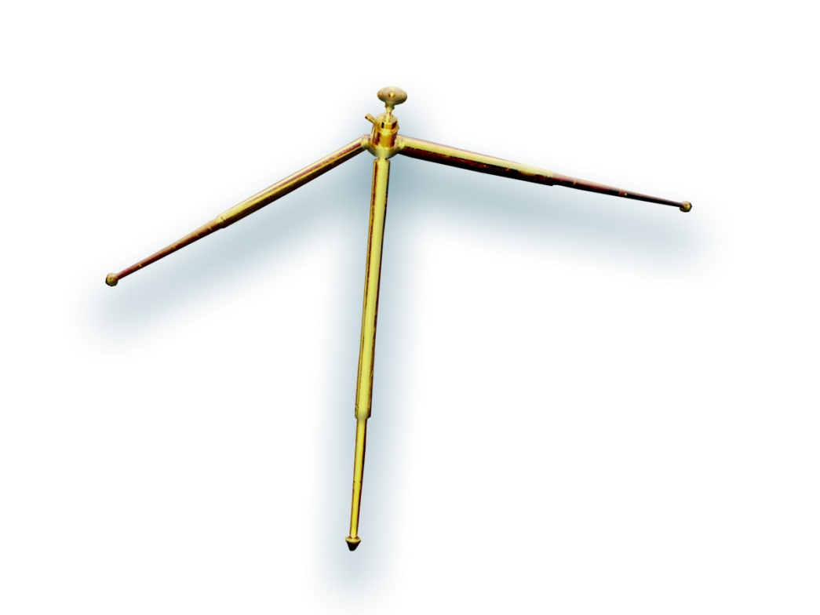
PROBLEM 16 :- oa, ob & oc are three lines, 25mm, 45mm and 65mm
long respectively.All equally inclined and the shortest
is vertical.This fig. is TV of three rods OA, OB and OC
whose ends A,B & C are on ground and end O is 100mm
above ground. Draw their projections and find length of
each along with their angles with ground.
TV
O
65 mm
25mm
C
A
FV
45 mm
B

Slide 35
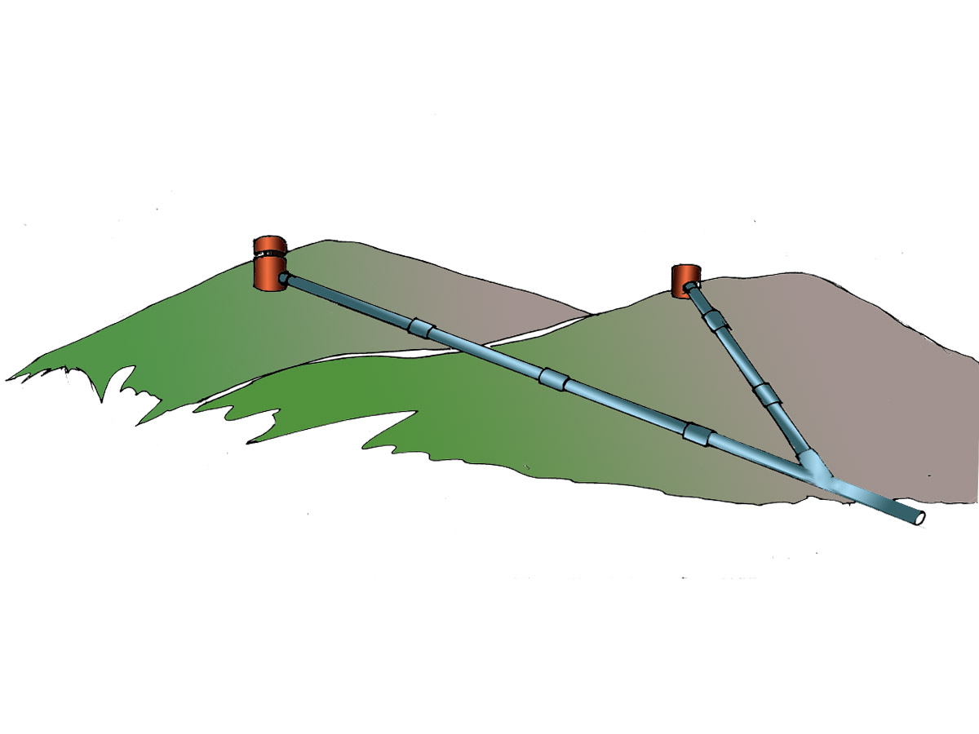
PROBLEM 17:- A pipe line from point A has a downward gradient 1:5 and it runs due East-South.
Another Point B is 12 M from A and due East of A and in same level of A. Pipe line from B runs
20⁰ Due East of South and meets pipe line from A at point C.
Draw projections and find length of pipe line from B and it’s inclination with ground.
5
N
1
Downward Gradient 1:5
A
12 M
B
E
C
S

Slide 36
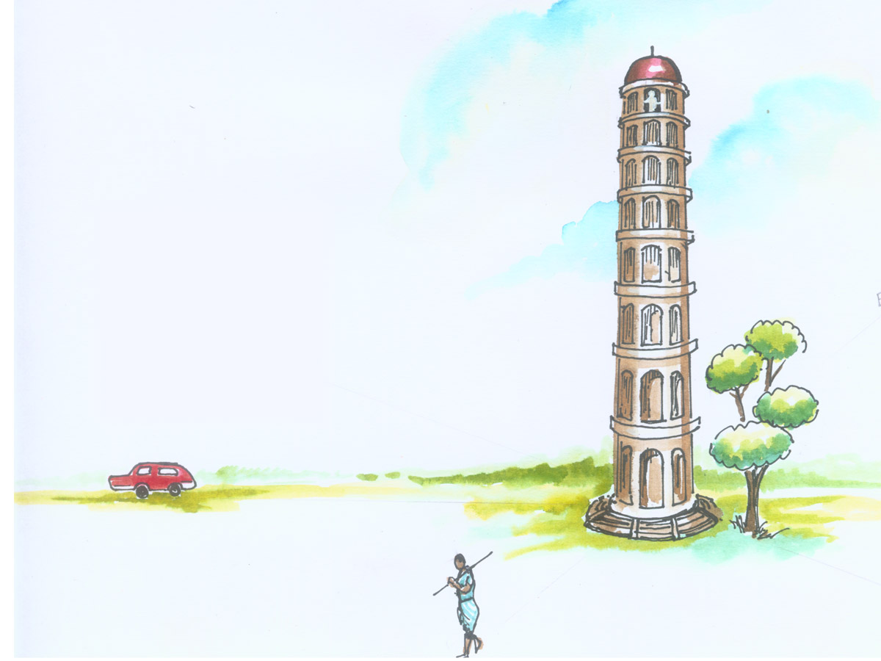
PROBLEM 18: A person observes two objects, A & B, on the ground, from a tower, 15 M high,
At the angles of depression 30⁰ & 45⁰. Object A is is due North-West direction of observer and
object B is due West direction. Draw projections of situation and find distance of objects from
observer and from tower also.
O
30⁰
45⁰
N
A
S
B
W

Slide 37
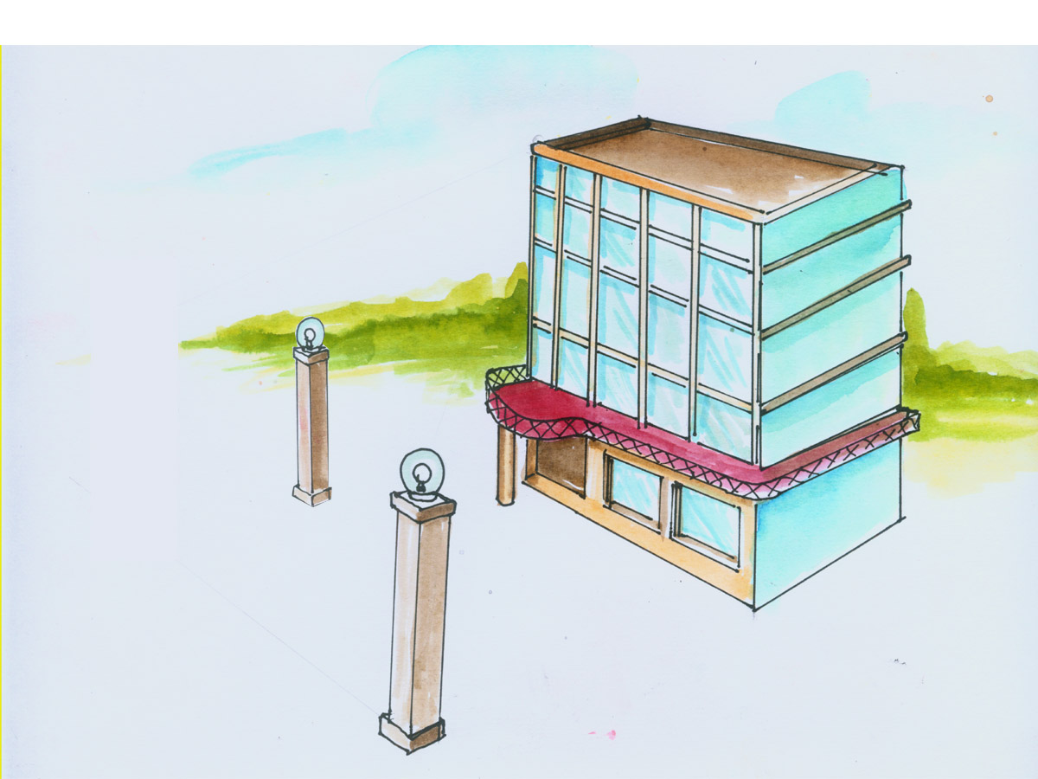
PROBLEM 19:-Guy ropes of two poles fixed at 4.5m and 7.5 m above ground,
are attached to a corner of a building 15 M high, make 300 and 450 inclinations
with ground respectively.The poles are 10 M apart. Determine by drawing their
projections,Length of each rope and distance of poles from building.
TV
C
15 M
A
30⁰
4.5 M
45⁰
B
FV
10 M
7.5M

Slide 38
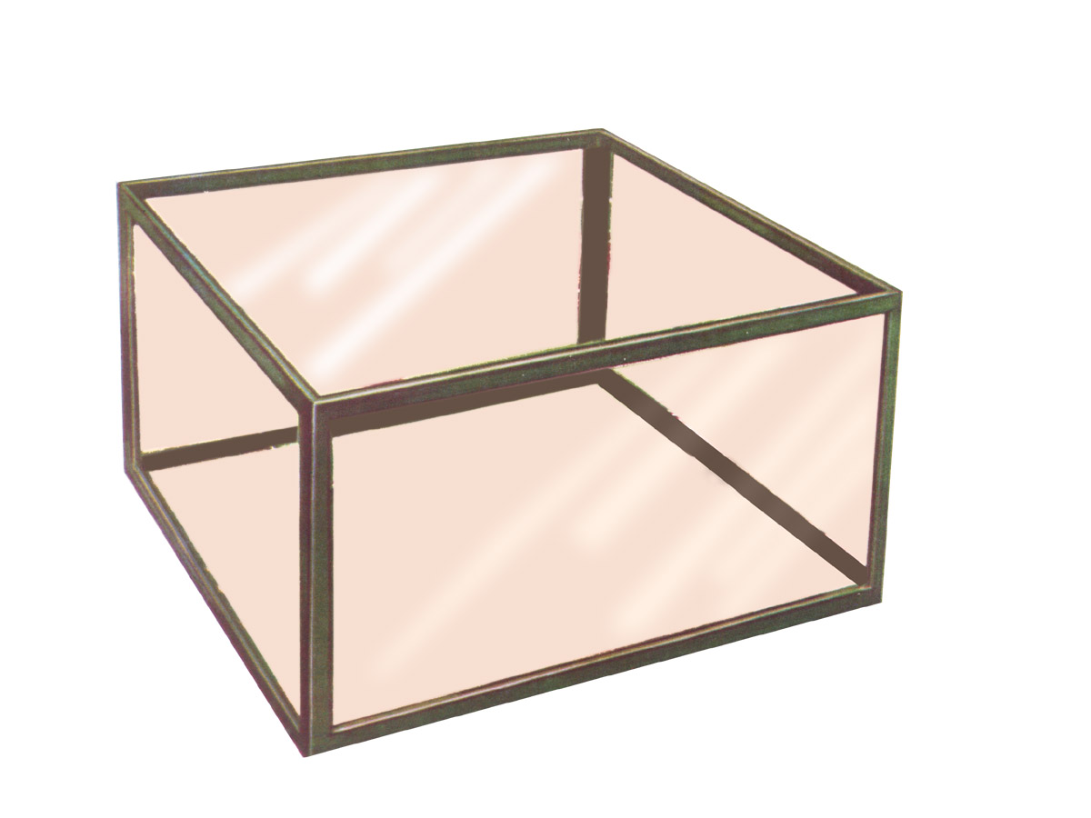
PROBLEM 20:- A tank of 4 M height is to be strengthened by four stay rods from each corner
by fixing their other ends to the flooring, at a point 1.2 M and 0.7 M from two adjacent walls respectively,
as shown. Determine graphically length and angle of each rod with flooring.
TV
4 M
1.2 M
0.7 M
FV

Slide 39
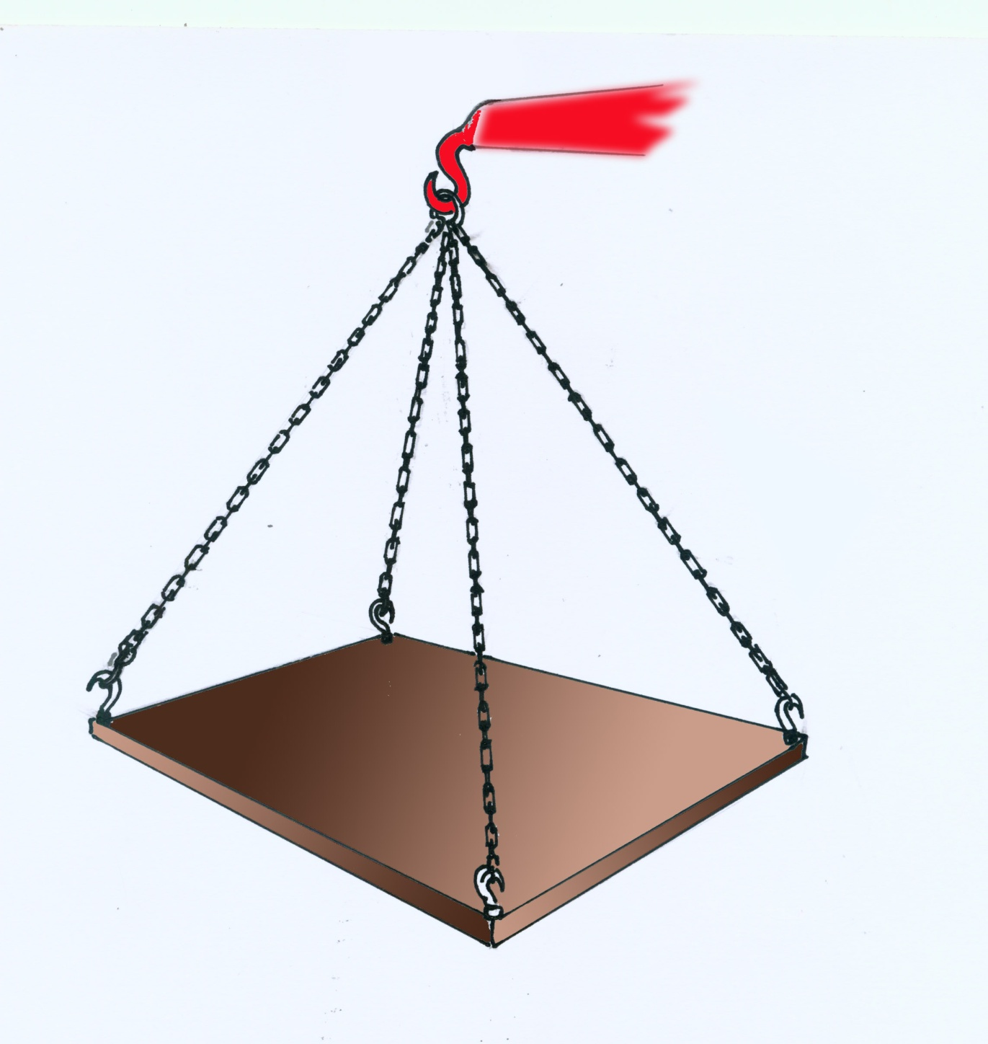
PROBLEM 21:- A horizontal wooden platform 2 M long and 1.5 M wide is supported by four chains
from it’s corners and chains are attached to a hook 5 M above the center of the platform.
Draw projections of the objects and determine length of each chain along with it’s inclination with ground.
TV
Hook
H
5 M
D
A
C
2 M
1.5 M
FV
B

Slide 40
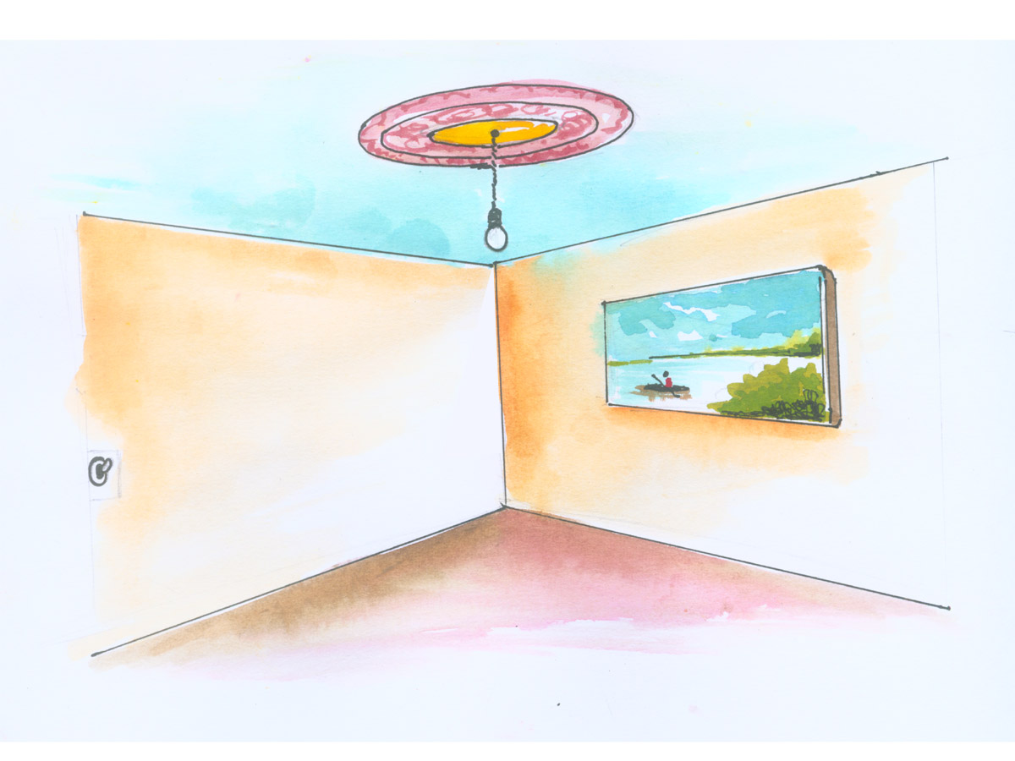
PROBLEM 22.
A room is of size 6.5m L ,5m D,3.5m high.
An electric bulb hangs 1m below the center of ceiling.
A switch is placed in one of the corners of the room, 1.5m above the flooring.
Draw the projections an determine real distance between the bulb and switch.
Ceiling
TV
Bulb
Side wall
Front wall
H
Switch
L
D
Observer

Slide 41
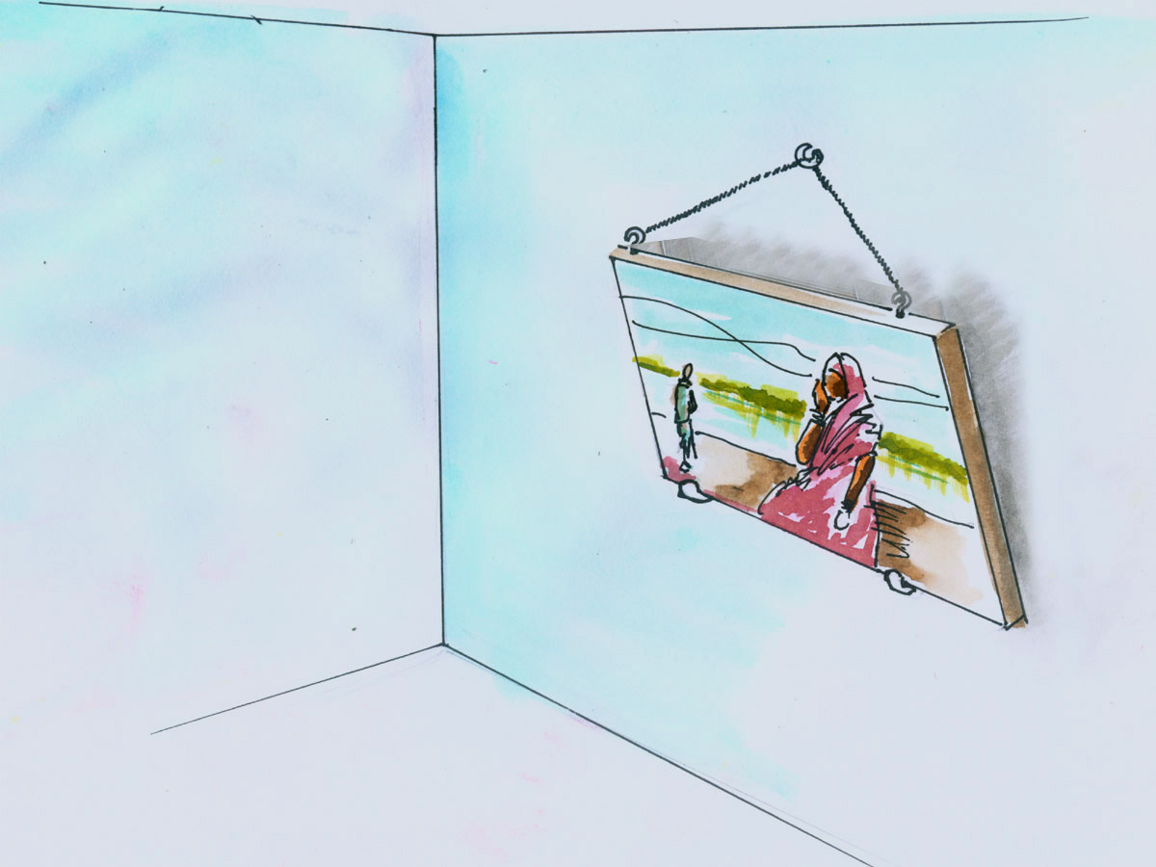
PROBLEM 23:-
A PICTURE FRAME 2 M WIDE AND 1 M TALL IS RESTING ON HORIZONTAL WALL RAILING
MAKES 35⁰ INCLINATION WITH WALL. IT IS ATTAACHED TO A HOOK IN THE WALL BY TWO STRINGS.
THE HOOK IS 1.5 M ABOVE WALL RAILING. DETERMINE LENGTH OF EACH CHAIN AND TRUE ANGLE BETWEEN THEM
TV
35⁰
1.5 M
1 M
FV
2 M
Wall railing

Slide 42
PROBLEM NO.24
T.V. of a 75 mm long Line CD, measures 50 mm.
End C is 15 mm below Hp and 50 mm in front of Vp.
End D is 15 mm in front of Vp and it is above Hp.
Draw projections of CD and find angles with Hp and Vp.
SOME CASES OF THE LINE
IN DIFFERENT QUADRANTS.
REMEMBER:
BELOW HP- Means- Fv below xy
BEHIND V p- Means- Tv above xy.
d’
d’₁
LOCUS OF d’ & d’₁
FV
TL
X
Y
θ
d
d₁
LOCUS OF d & d₁
c’
TL
TV
c
Φ

Slide 43
PROBLEM NO.25
End A of line AB is in Hp and 25 mm behind Vp.
End B in Vp.and 50mm above Hp.
Distance between projectors is 70mm.
Draw projections and find it’s inclinations with Ht, Vt.
LOCUS OF b’ & b’₁
b’
b’₁
FV
TL
a
Φ
X
TV
TL
Y
a’
θ
b
b₁
LOCUS OF b & b₁
70

Slide 44
PROBLEM NO.26
End A of a line AB is 25mm below Hp and 35mm behind Vp.
Line is 300 inclined to Hp.
There is a point P on AB contained by both HP & VP.
Draw projections, find inclination with Vp and traces.
a
Φ
b’
b’₁
LOCUS OF b’ & b’₁
FV
TL
35
p
p’
y
X
p’₁
25
θ=30⁰
TV
a’
TL
b
LOCUS OF b & b₁
b₁

Slide 45
PROBLEM NO.27
End A of a line AB is 25mm above Hp and end B is 55mm behind Vp.
The distance between end projectors is 75mm.
If both it’s HT & VT coincide on xy in a point,
35mm from projector of A and within two projectors,
Draw projections, find TL and angles and HT, VT.
b
b₁
TV
55
TL
a’
θ
25
X
Y
Vt
Ht
FV
Φ
TL
a
35
b’
b’₁
75

Slide 46
Thank You

